Slide 1

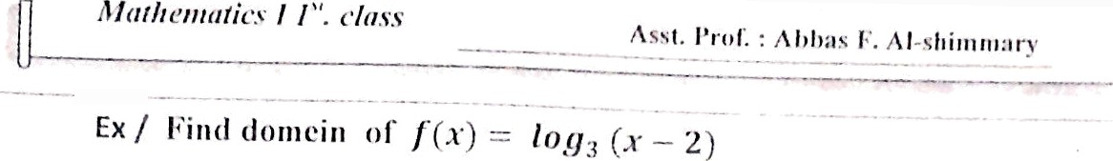




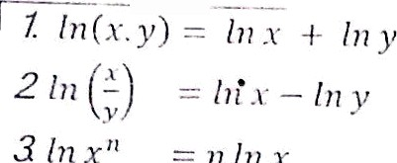
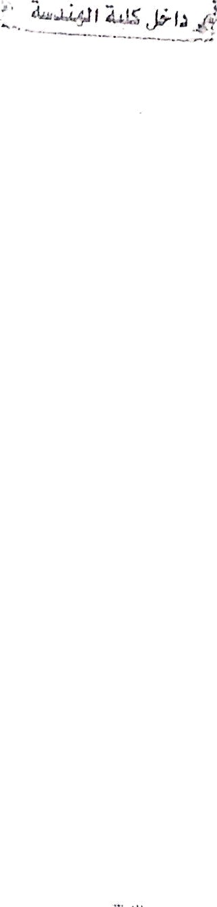

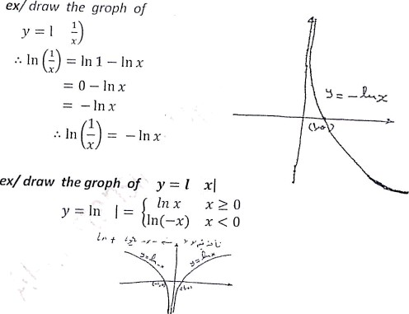
* — 2 > 0
x > 2
Properties
i f y —— In u then ^{dy _}
1 du
dx u dx
exf Let y —— In(sin x)
Find d y /dx
s
qp — _{s}p . COS X — $ g —— co i x
61

Slide 2
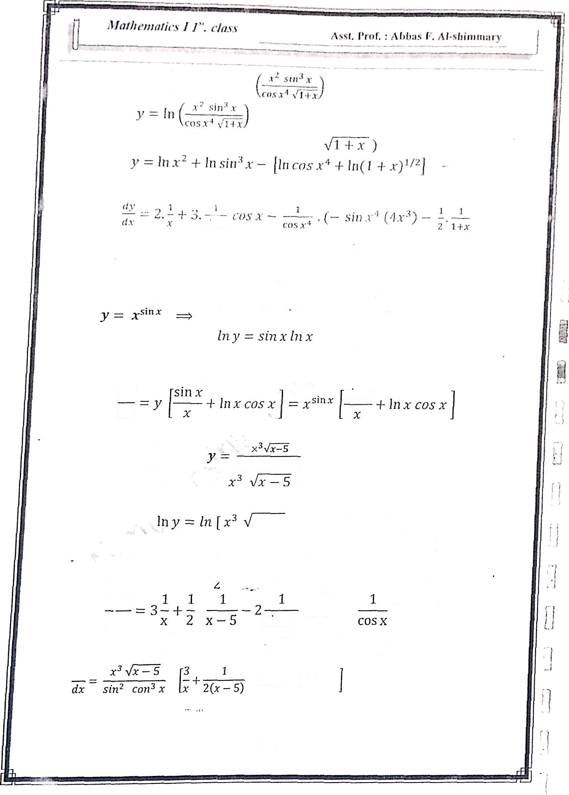




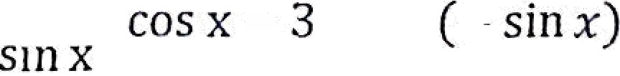

e»/ Find
^x
y p(a sin * )
li›( cos x’
dy
—² +
dx
2(1 + x)
ex/ let y
x ^{S} '• •
Fund y
In y In x•'••
1 dy
sin x .
1
-Ł In x. cos x
dy
dx
y dx
Sllj X
Lx/ Tind
dy
dx
Sİ Ij2
X
COC X
In y = ln(
2
s cos ^{3 '}
x 5] In y — fn x³ + ln(x — 5)''
In[ sin'x ros³x J
( In sin'x -ł- In cos’xJ
In y 3 fø x + /n(x 5)
1 dy
y dx
2 In sin x 3 In ros x
ax
dx
"'ï
¹ 2 cotx + S taø r)
d y
— 2 cot x 4 3 tan x
62
‘

Slide 3

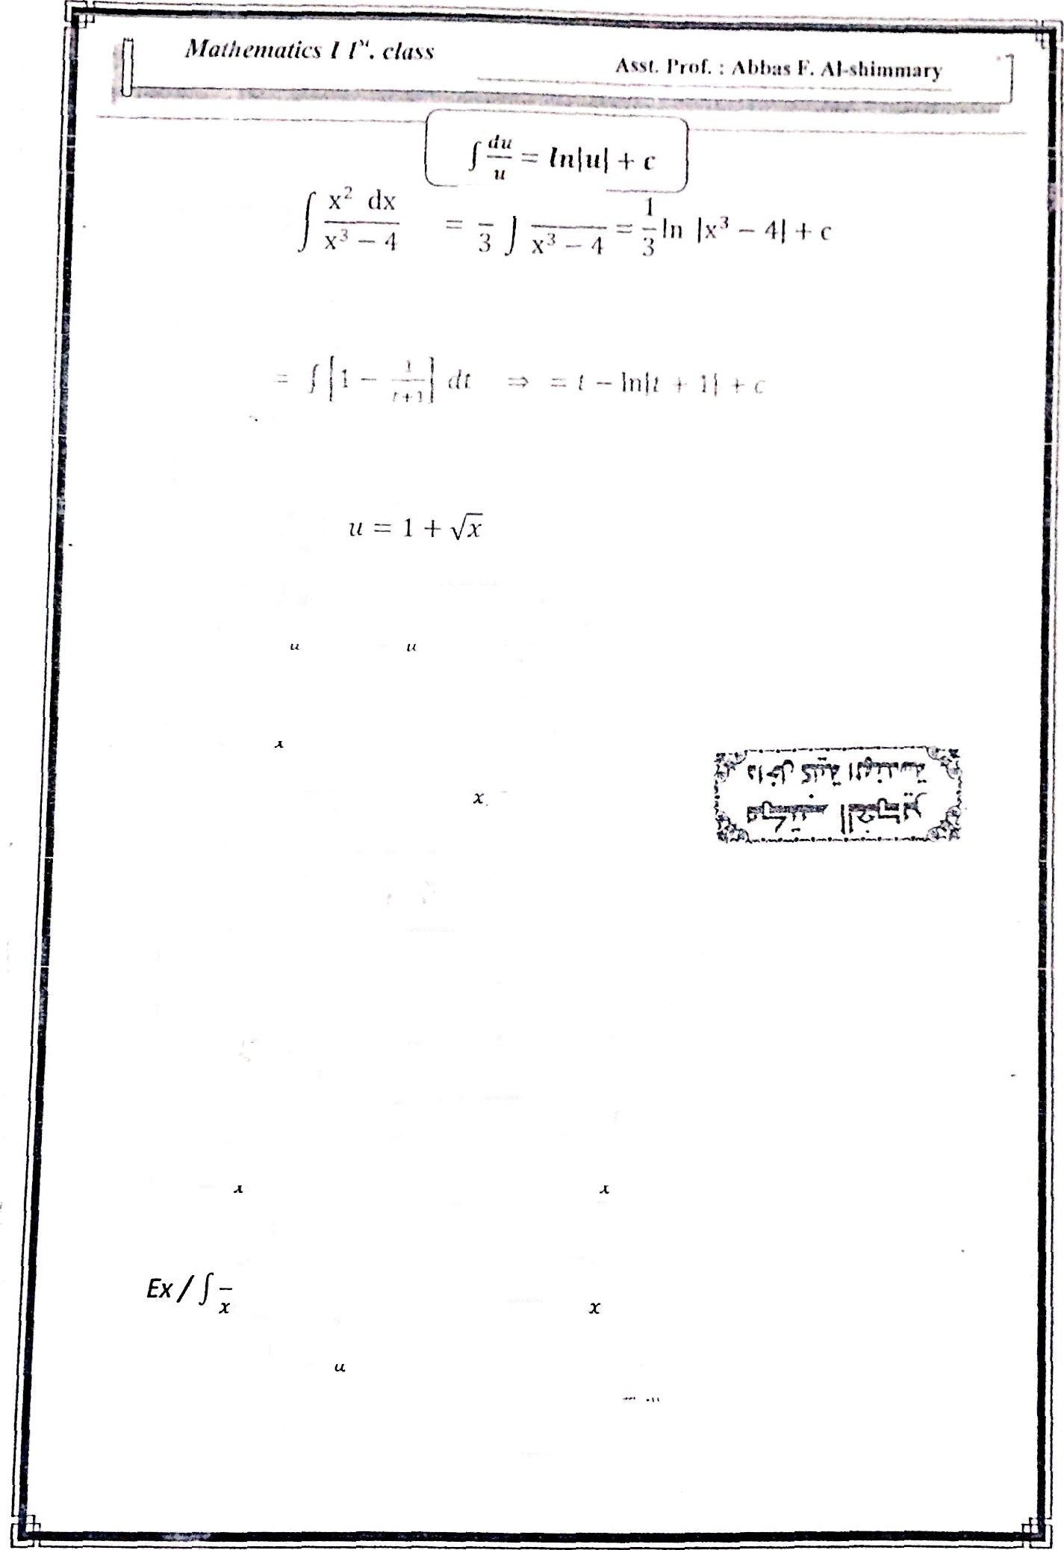



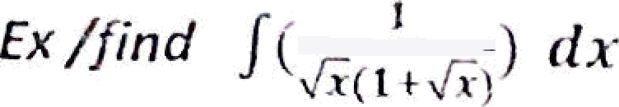






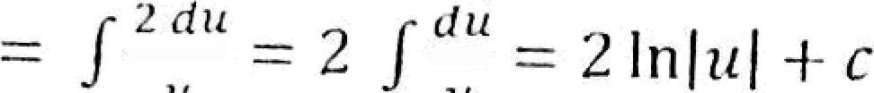
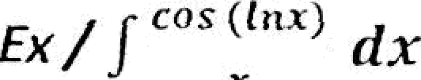

fixJ finil
Ex / find ( '
-- 2 lu)1 + çÑ( + r
Let u ---- lnx: dii ---- -' dx
- ) COS tt du --- sin u + c
-- sin(/nx) + c
Ex/ cat x dx ----
COSF _{dx}
---- ln)sin x[ + c
sec x+ tan x)
Ex/ f sec x dx ---- / secx •
(sec x+ tan x)
dx
sec’ x+ sec x tan z
secx+ tan x
dx
= le ]sec x + ten x) + c
fx‘// ^{n} dx
'
let u --- /nx m du -- dx
-- z d ^{u-'} f c --- ' ^{l} "-- + c
de
let u --- ln x =x
dx
d
= / = fn }x} + c = fr JfnxJ -F c
63

Slide 4
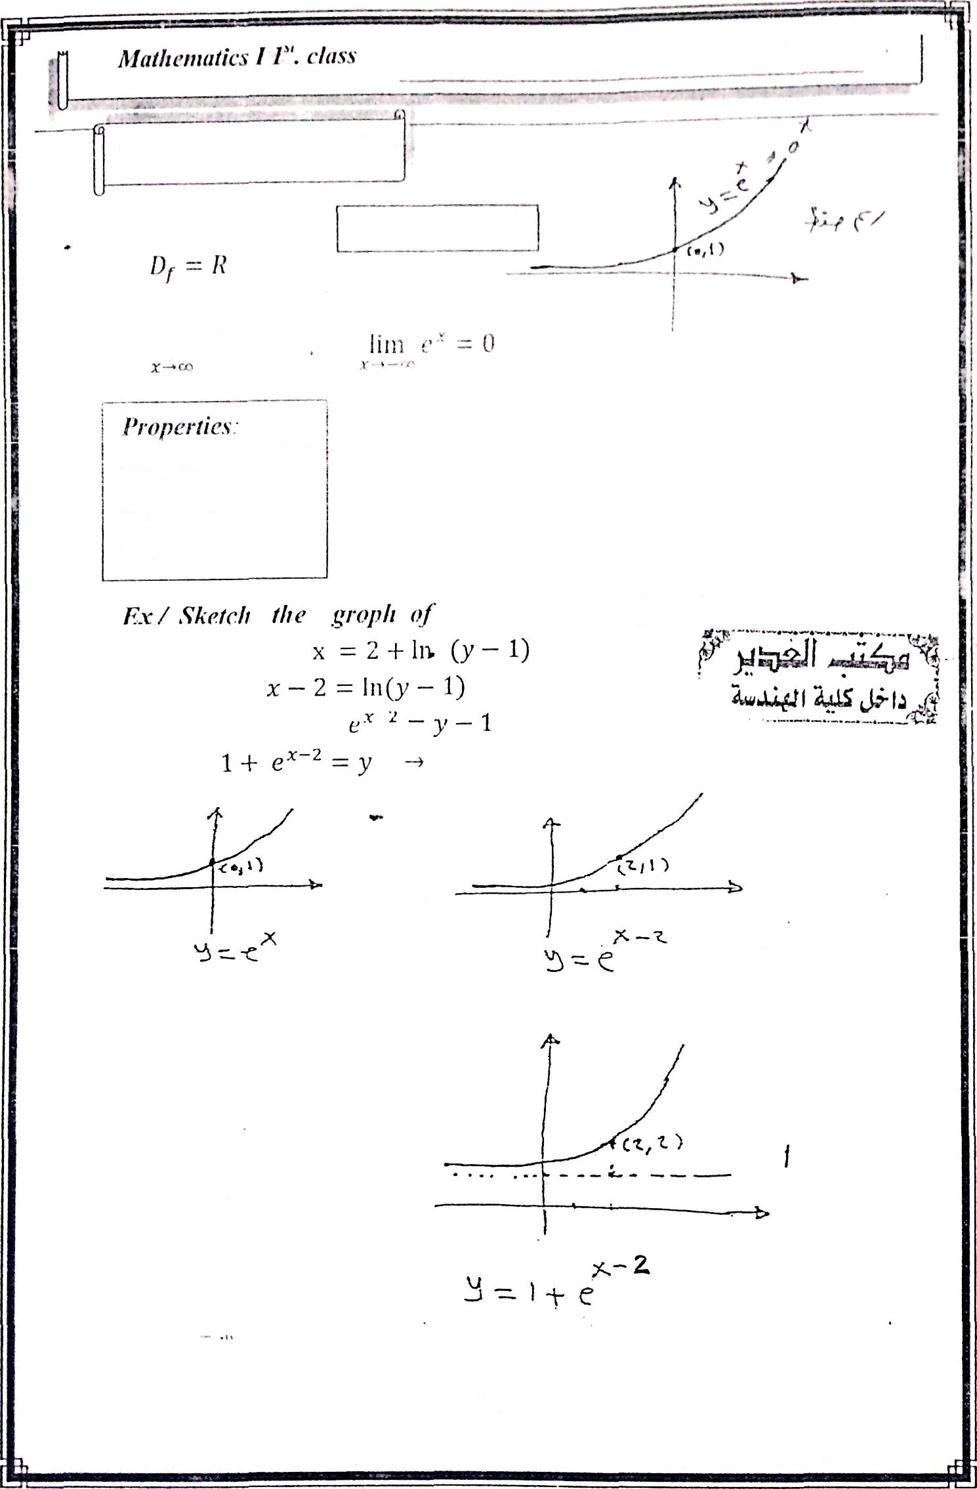

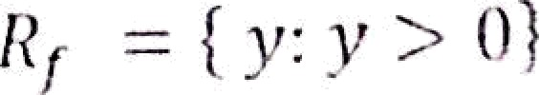


Alet. 1'rof. : AI ;› -
Al.slılınmary
The exyoııeıtliol]’ ıı ııctioıı
1. e* . e —- e*“!
<
3. ( e°)" = e^"
.x = 2 1- in(y - 1)
y = 1 ı— e^ ²
64

Slide 5
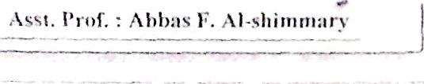
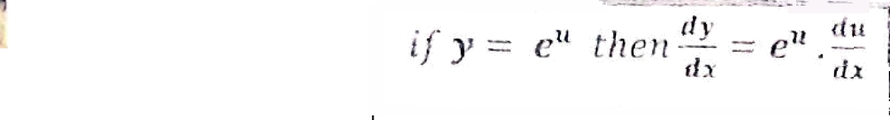




.
/ir*///nfir's 1 1". cl‹is.s
‹i y
Ex / where the graph of
y -— e’'
— ñ e’ — 4
intersect
x- axis
e’ + 1 = 0 e* = fi
e• —— —1 neglect Since
x = In 4
e^ > 0
olwnys
e"du —— e" + c
Let u — tan x
—— e° du —— e" c
du —— sec² x dx
—— _{e}tan x+
g
ex/ e ^{2 NX} dx: —- ‘) e'
2
dx ——
x’ dx —— 3 + c
Ex / e•! ^{e} dx
—— f e•. e^{d} dv let u —— e^
—— e" du —— e" + c
—— e^{e‘} + c
du = e*dz
2) p- u”*
3) (n*)" — n“
65

Slide 6

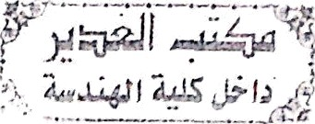













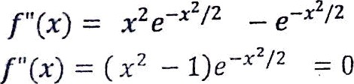
Ext find
dx
dy
= 2 ^{i A} . cos x . In 2
dx
y = c"’ + e". x^{e}
Ez/ Find
d y dx
i/
/ o" du —— ' a" + c
Ex / / 2""“ cosx dx let
_{in 2} 2" + c
u = sin z m du —— cos x dx
Ex / ] ’ _{e}
J(e• ) ^{1/2} dx ——
] e °•‘ dx
du -— — -_{z} dx
f e" du —— —2 e" + c
let u —- x
dx -- —2 du
z
f e" ( —2 du )•= —2
= —2 e + c , ›
Ex/ Find
2*e “
1+3 e^
2+e”
( ]
e"”
”note : e” - œ e" —+ 0
—
x *-› œ
:/I7n
g —+ ¢o 1+3 e^
kim 2 e” + 1
—+ œ e-^+3
e”*
0+1 _ t
" y
Ex / Sketch
” o+3 " 3
/(mj = e *!' ²
-s
the graph of
f(0) =
e’ = l
(0,1) is local max.

Slide 7
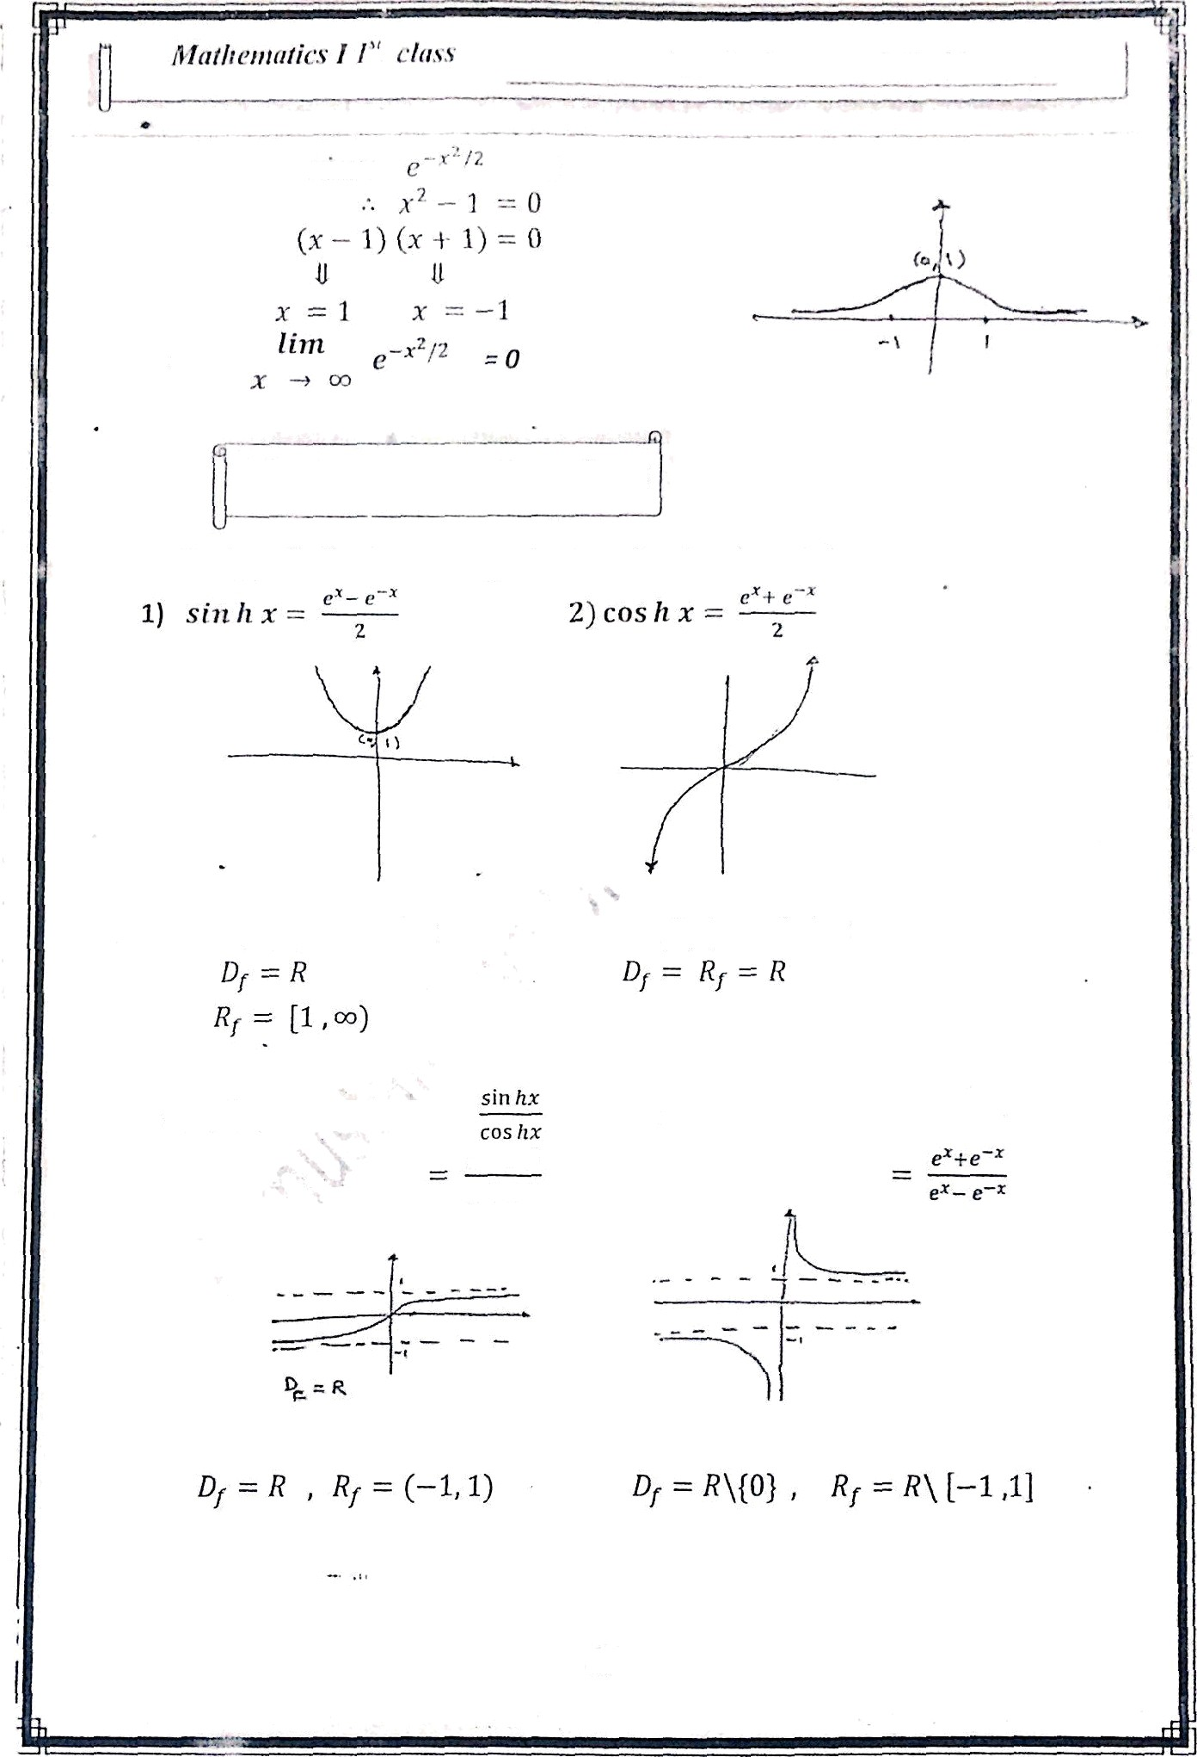

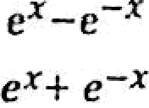

A.set. l'rof. : Alıl›ııs f•. Al-slıimnıary
0
ann
The hyperlı‹ılic fuııctiolıs
The hş•peı’1ıolic size and lo•pcı‘bolic cosine fıınclions dr fine a
f(x) —— cos h x
f(x) —- sin h x
3J /(x) = taü h x =
4] f(x) —- cot hx =
cos iz x
67

Slide 8

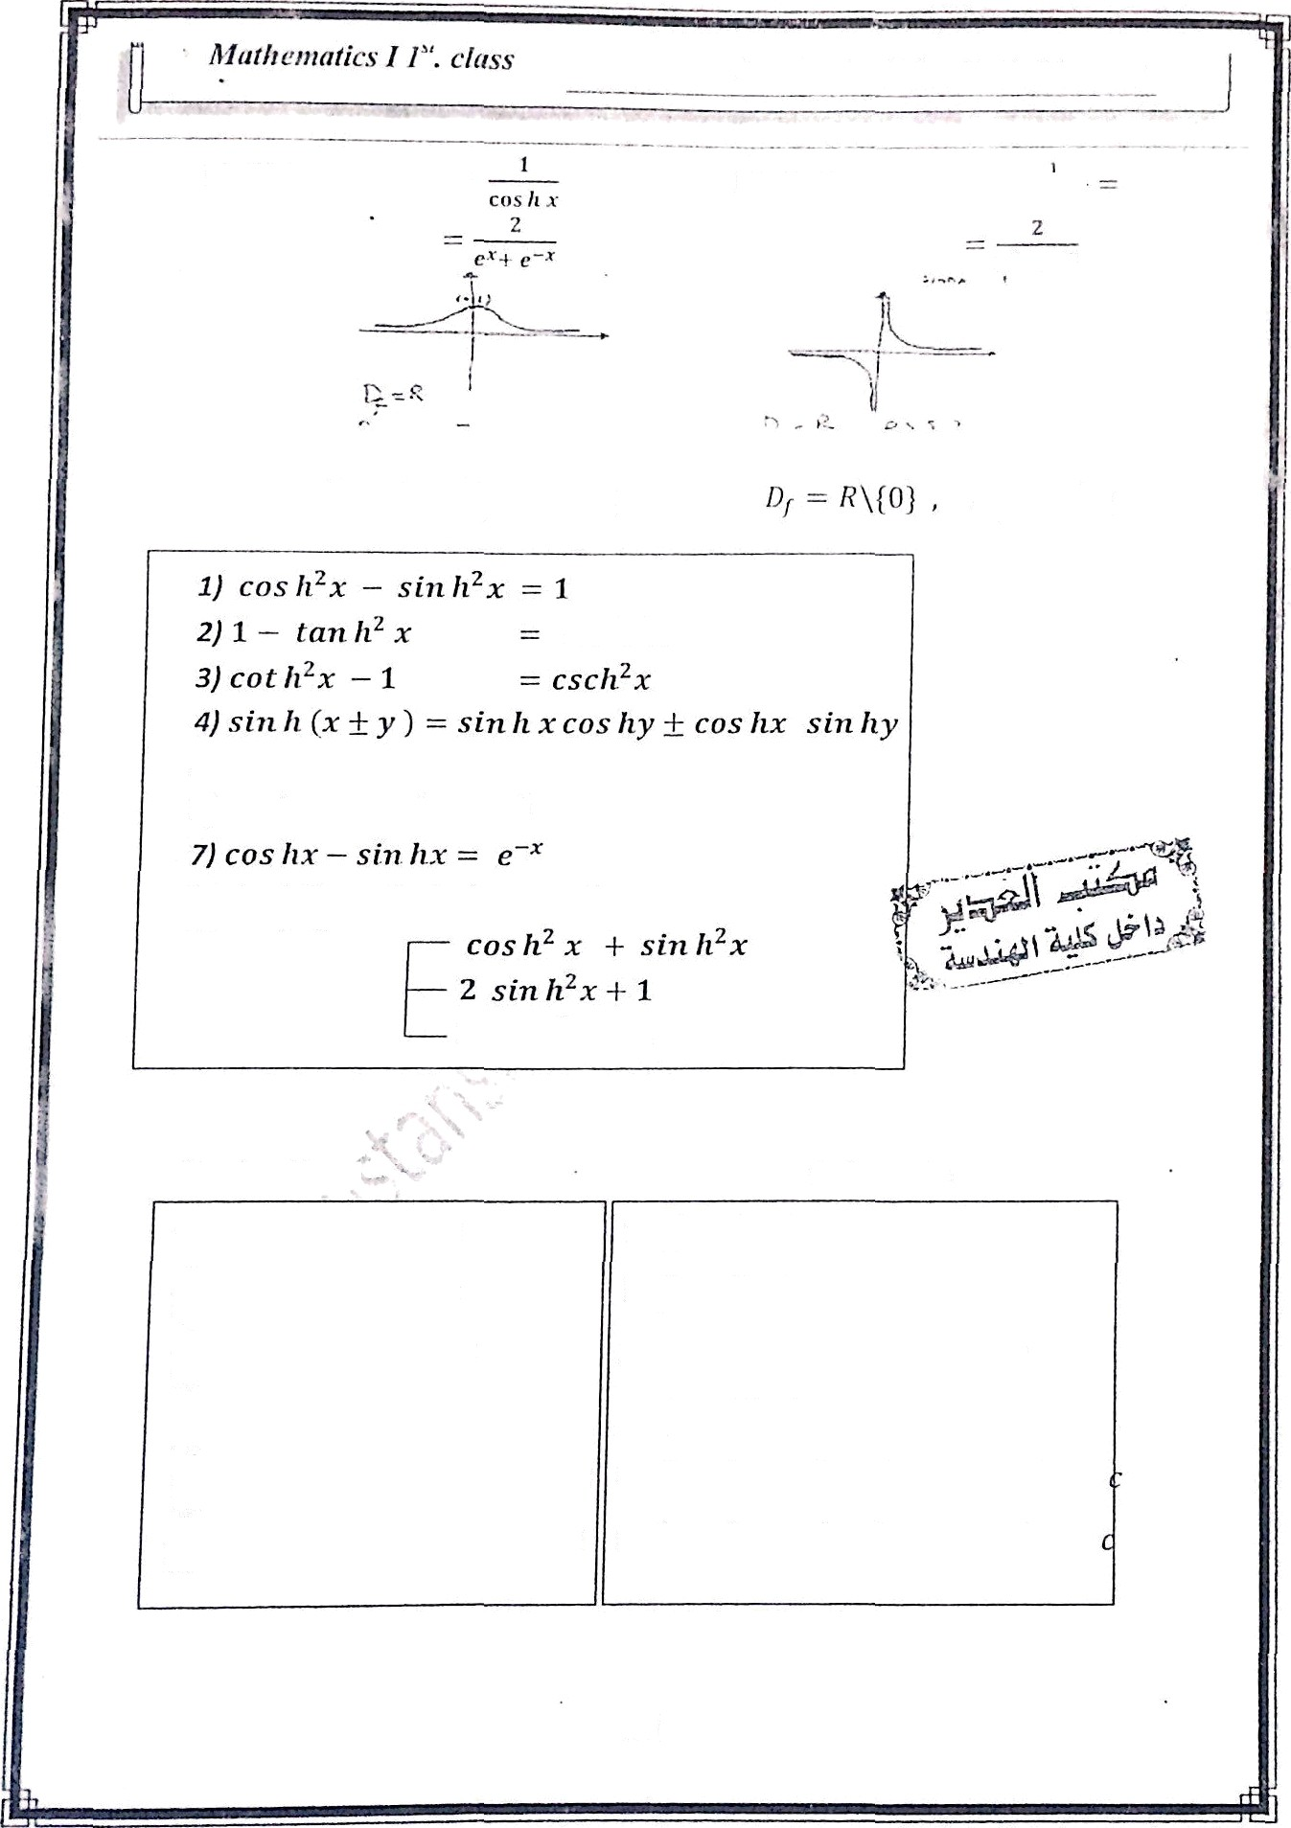





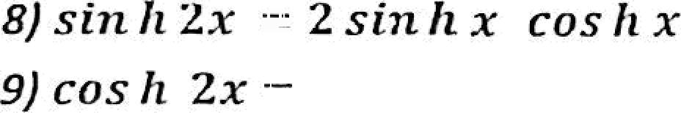






Asst. l’r‹›f. : Ablias I•’. Al-sliimniary
5) f(
) — sec hx
(0, 1]
ser fi² x
s5 cos h ( .v + v1 cos h x cue Ay + min li.v sin fry
6) coslix + sin hx - e•
2 nos h²x
1
Derivative
integrals
sln h x -I- c
d
(sin £x) -• cos hx
l- cos fi xdx
dx
d
/ sin hx dx - cos h x + c
/ sec A² x dx tan h x -I- c
dx
(tan Ax )
(cot hx )
(sec hx )
sec fi² x
csc h²x
sechx tan 7ix
csc h' xdx -— —cot hx 1 c
/ sec Ax tan hx dx sec fix -1-
dx
_{g}d
d
68

Slide 9









AsSt. l'rof. : Al›l›nfi h”. Al-*hinima n'
f.'“.U prrn'‹• tlmt ros lt ('iv) = 4 cos tr' z — 3 cos ft x ct›x Jr (3i) = ttis li (z -l- 2z)
= tos li x c‹is li 2z + sin liz sin h 2z
-- cos h.x (2 cos fi" x — 1) + sin hx ( 2 sin h x cos hx )
— 2 kris #’ z — cos úx + 2 sin fi' z cos hz
= 2 cu s h’ x — cos hx + 2 (cos fi" r — 1 ) cos liz
= 2 cus lt' z — cos dx + 2 cos h' K — 2 Cos hx
= 4 cos h’x — 3 cox liz
sin h x —— — ros /tz
e• e •
2 4
e
2
1 _{e} 1
+ 4
— 1 =
1
= 1 + 4
4
3
e'• = =r 2z = ln
“
r 3
4
5
5
3
2z = fti5 — fn3
z — [lu 5 — fn3]
Ex/ find
d d‹
dx
By.the 2' t^{d} fundameutal
i i
theorem of colculus
i
dx / sho/ ihat y —— e"* sinli bx salisfies y" - 2e y’ + ( a* 4 b!))/ —— 0
y' —— b e’ cosh bz + o e°' sin h bx
y" = b’e’ sith bz -F nb s“ cos bz -l- ab e’ cos h bo.-I- a ²e°* sin hbz
y” — e“ sin/l bz (a ² -F b’) + 2 ab e°^ cos hb z
y" — 2 a y’ + ( n² -F b ² ) y = ( a’ + b’)e°• sin hb x + 2nb e°• cos hbx
— Z a [b e°• cos fiz + ti e°‘ sin h bx] + (n² + b’)e°' sin h bz) = 0
69

Slide 10
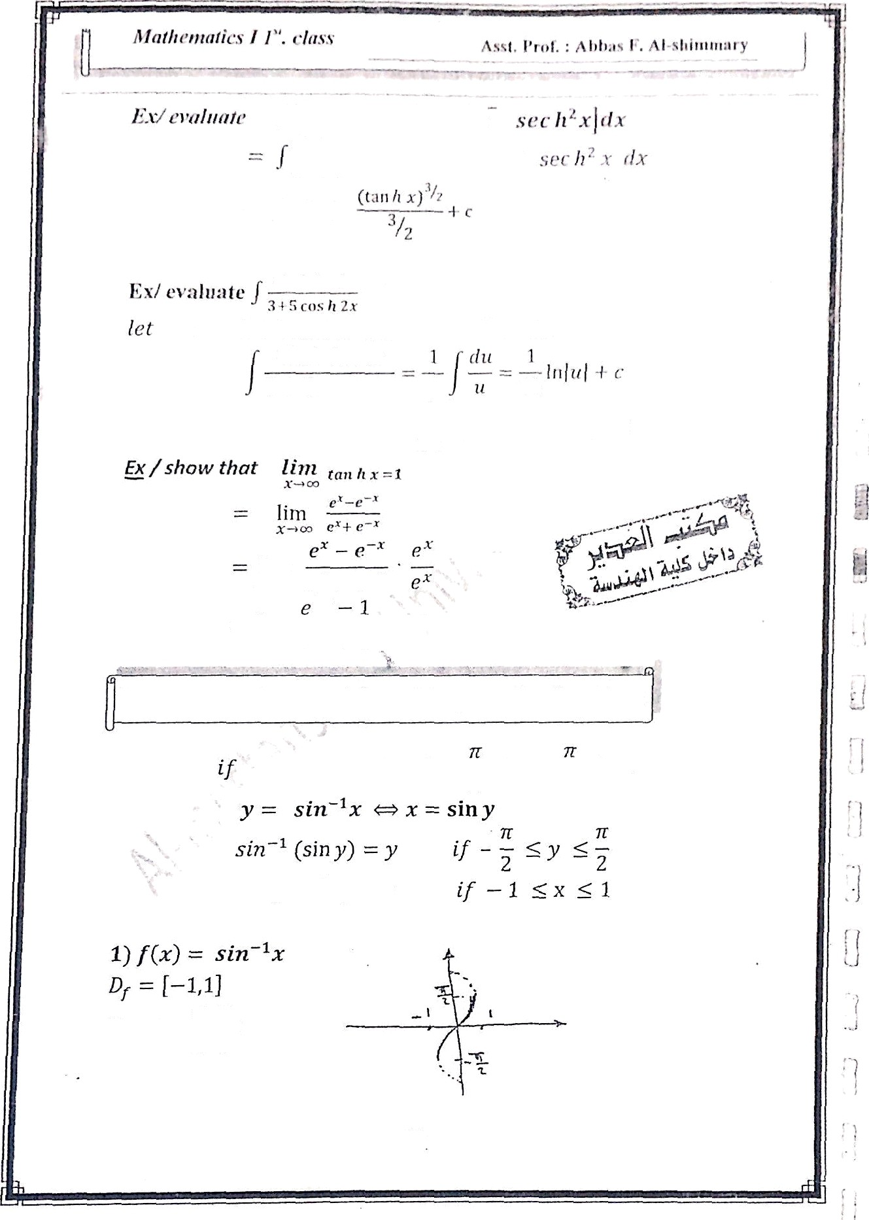

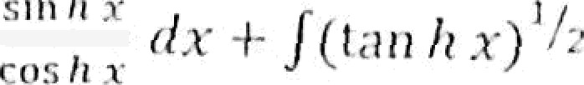

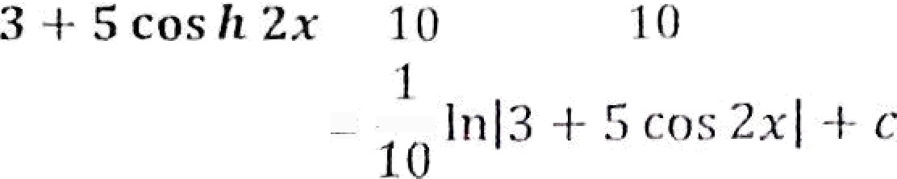
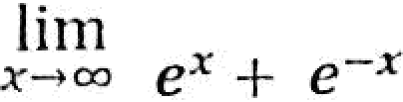

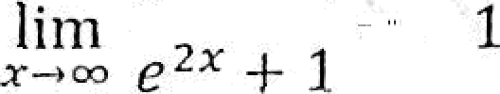

sin fi 2.r iJ.r
sin fi 2x dx
Inverse of Trigonometric and huperbo ic functions
1 < x •t 1 and
< y < ₂ then
’f ' 2 1'
70

